Slide 1

MALIGNANT COMMENTS
CLASSIFIER
Presented By:
NITISH KUMAR SHARMA

Slide 2
PROBLEM STATEMENT
Researchers have found that hate is a problem across multiple platforms, there is a lack of models for online hate detection. Online hate, described as abusive language, aggression, cyberbullying, hatefulness and many others has been identified as a major threat on online social media platforms.
There has been a remarkable increase in the cases of cyberbullying and trolls on various social media platforms. Many celebrities and influences are facing backlashes from people and have to come across hateful and offensive comments. This can take a toll on anyone and affect them mentally leading to depression, mental illness, self-hatred and suicidal thoughts.
Internet comments are bastions of hatred and vitriol. While online anonymity has provided a new outlet for aggression and hate speech, machine learning can be used to fight it. The problem we sought to solve was the tagging of internet comments that are aggressive towards other users.
Our goal is to build a prototype of online hate and abuse comment classifier which can used to classify hate and offensive comments so that it can be controlled and restricted from spreading hatred and cyberbullying.

Slide 3
EDA STEPS
We will start by importing the libraries that we require for performing EDA. These include NumPy, Pandas, Matplotlib, and Seaborn for visualization, handling dataset and mathematic computation.
We will now read the train and test data from CSV files into a Pandas DataFrame.
We will display top 5 rows of train and test data by using .head() function to know if it has the right type to data in it or not.
Using .shape function to display total number of rows and columns present in the train and test dataset.
Using .columns function to display all the features name present in the train and test dataset.
We will now check datatype of each variables of train and test data by using .info() function.

Slide 4
Use describe() function to get statistical details like count, percentiles, mean, std, and maximum value of a train and test data.
We will now check for null values in our train and test dataset. We will use isnull().sum() function. Both train and test dataset has no null values.
Now we will do univariate analysis on train data to extract information from it.
As we have mostly categorical data, so we will visualize them all in a pie chart to get better understanding of it.

Slide 5
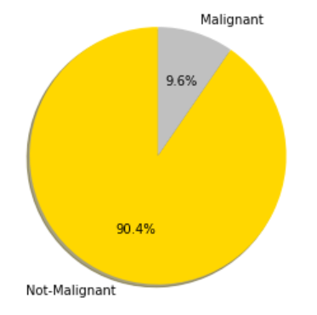
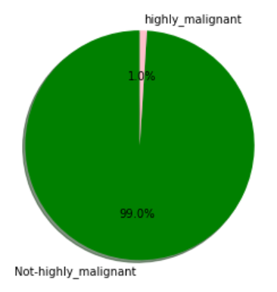
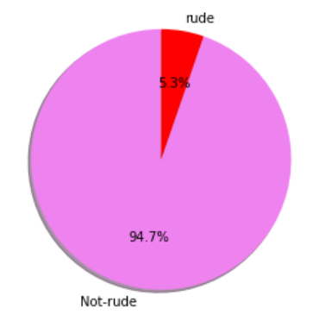
VISUALIZATIONS
Comments which are stated as malignant is 9.6% and rest 90.4% is not-malignant.
Comments which are stated as highly malignant is 1% and rest 99% is not-highly malignant.
Comments which are stated as rude is 5.3% and rest 94.7% is not-rude.

Slide 6
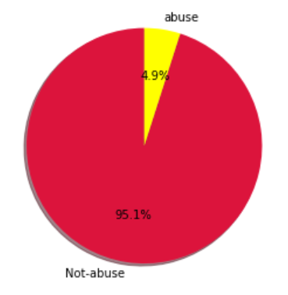
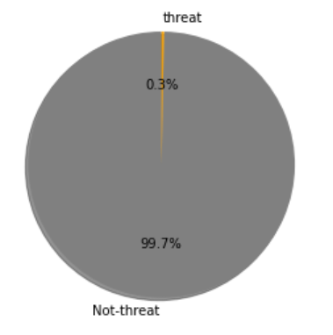
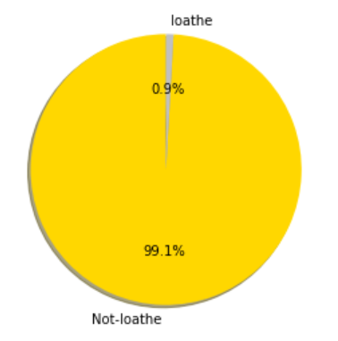
Comments which are stated as abuse is 4.9% and rest 95.1% is not-abuse.
Comments which are stated as threat is 0.3% and rest 99.7% is not-threat.
Comments which are stated as loathe is 0.9% and rest 99.1% is not-loathe.

Slide 7
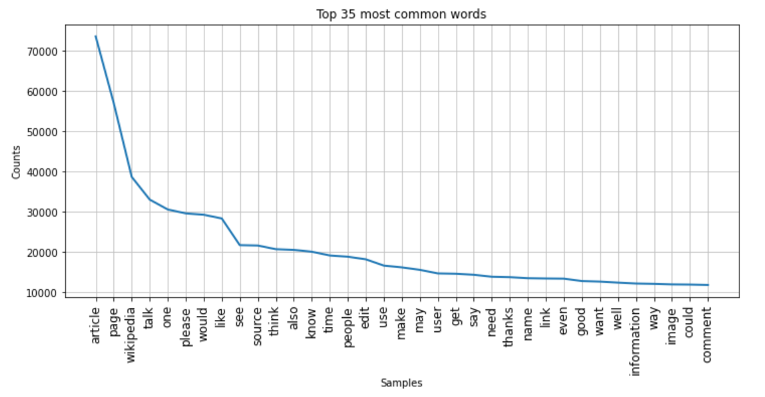
These are 35 most frequently used non-toxic words from the cleaned comments column according to its number of occurences in descending order.

Slide 8
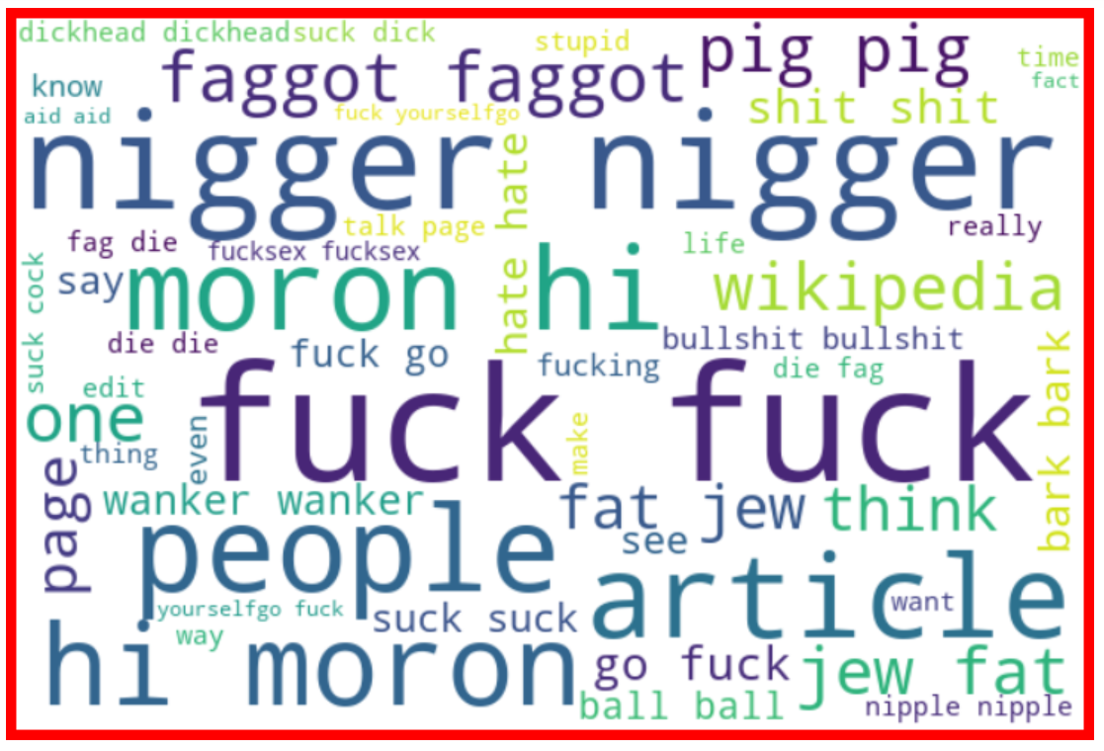
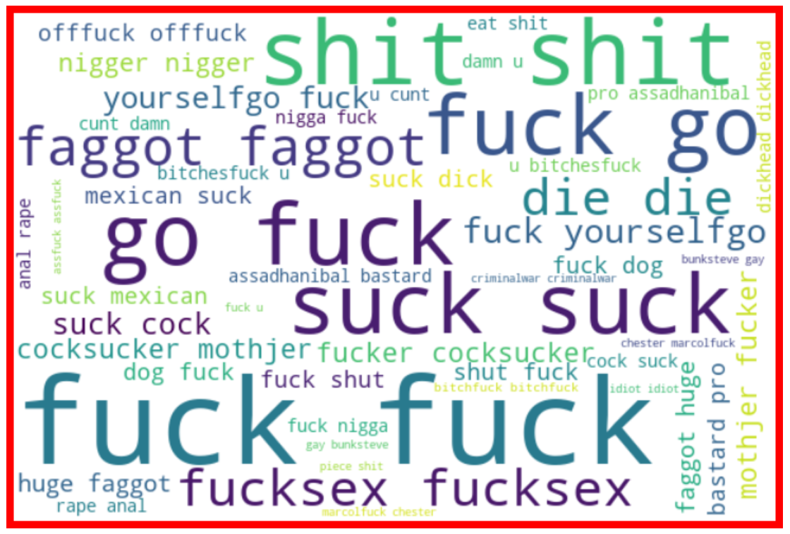
OFFENSIVE WORDS
MALIGNANT
HIGHLY MALIGNANT

Slide 9
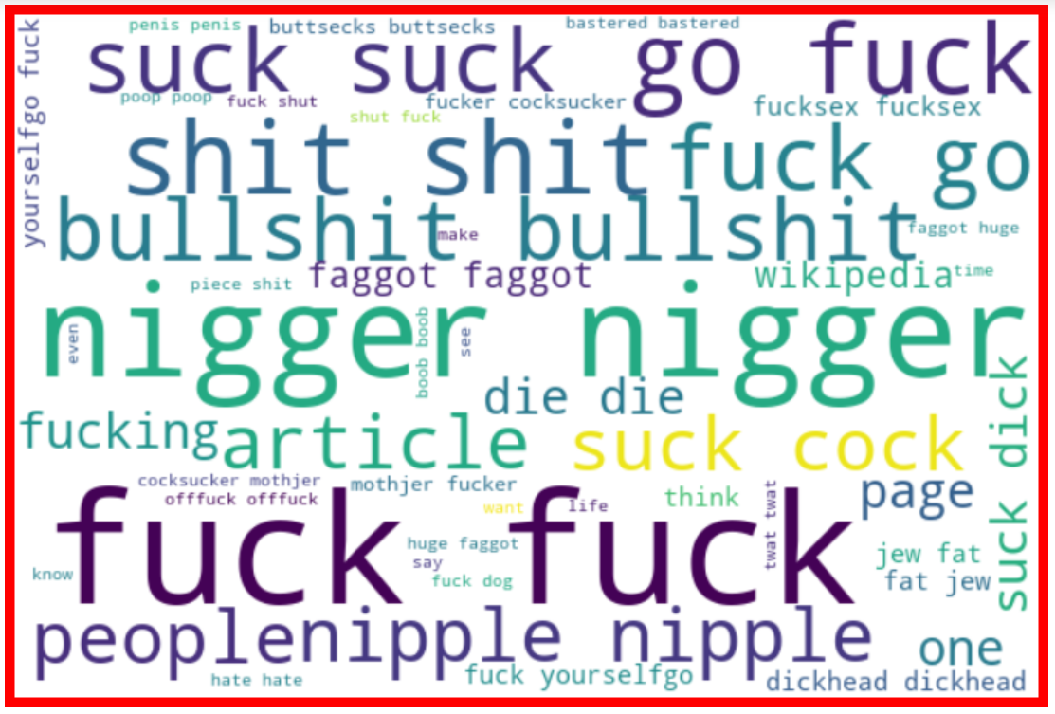
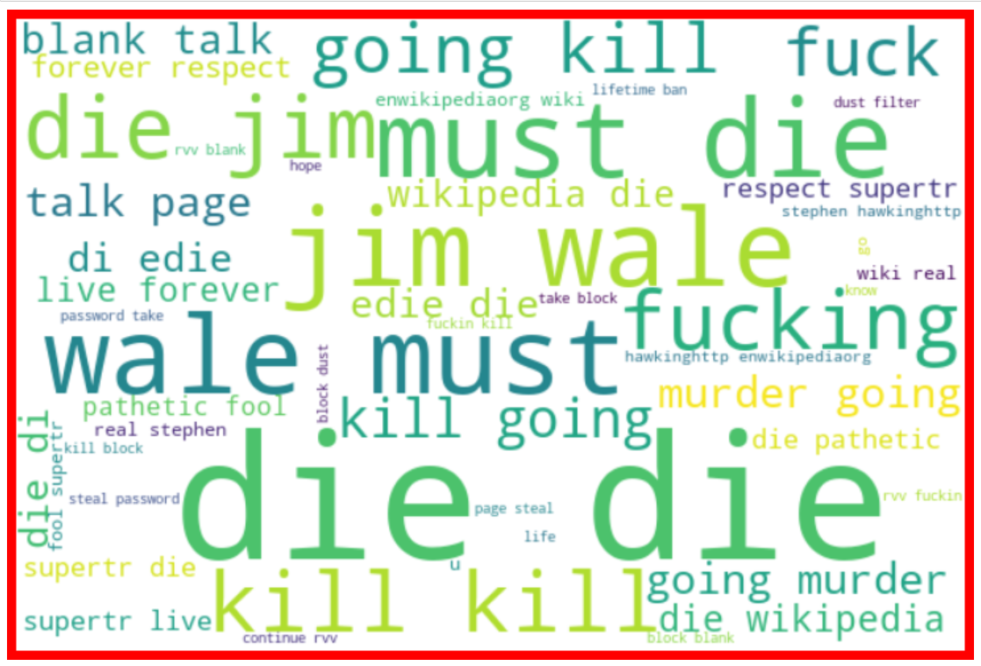
OFFENSIVE WORDS
RUDE
THREAT

Slide 10
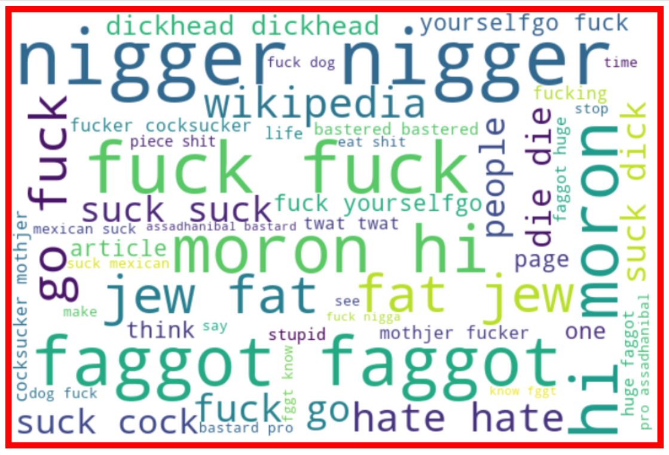
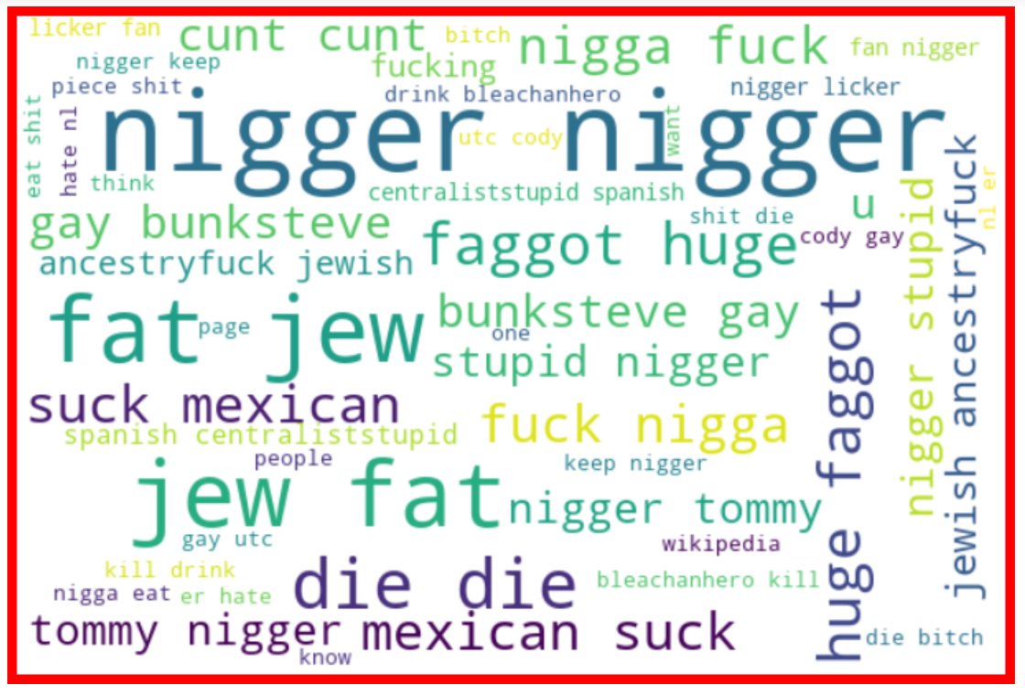
OFFENSIVE WORDS
ABUSE
LOATHE

Slide 11
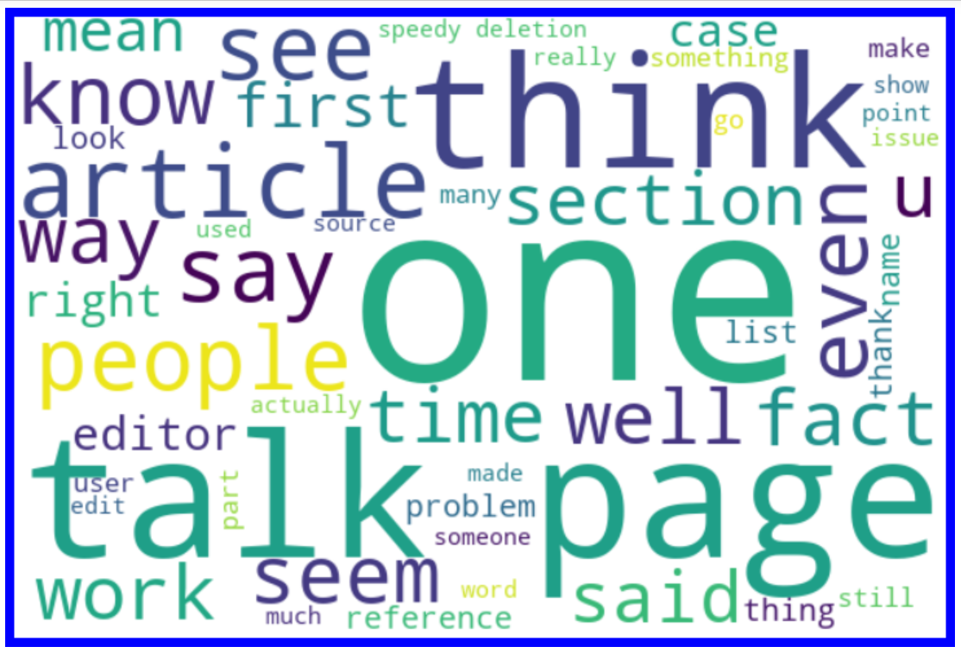
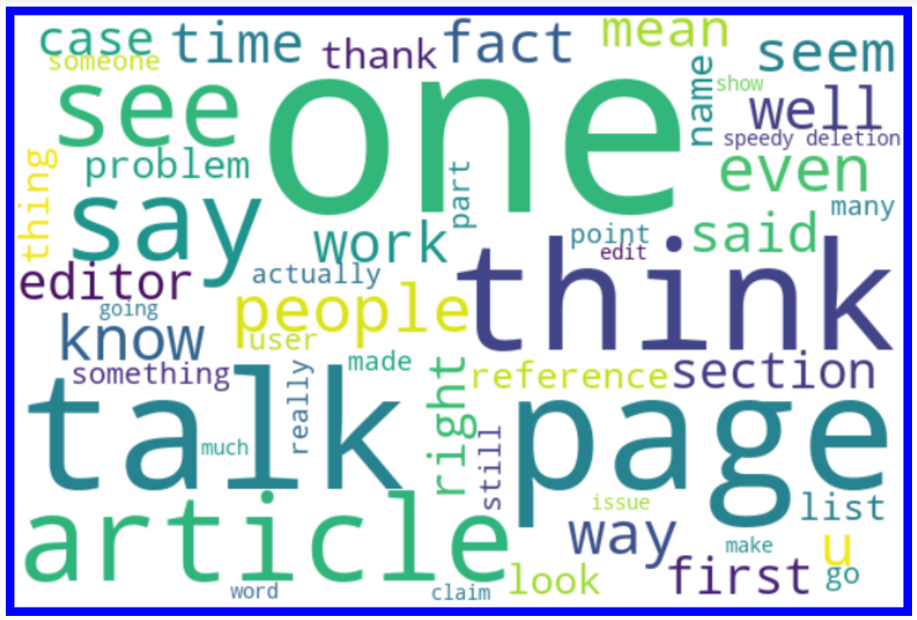
NON-OFFENSIVE WORDS
MALIGNANT
HIGHLY MALIGNANT

Slide 12
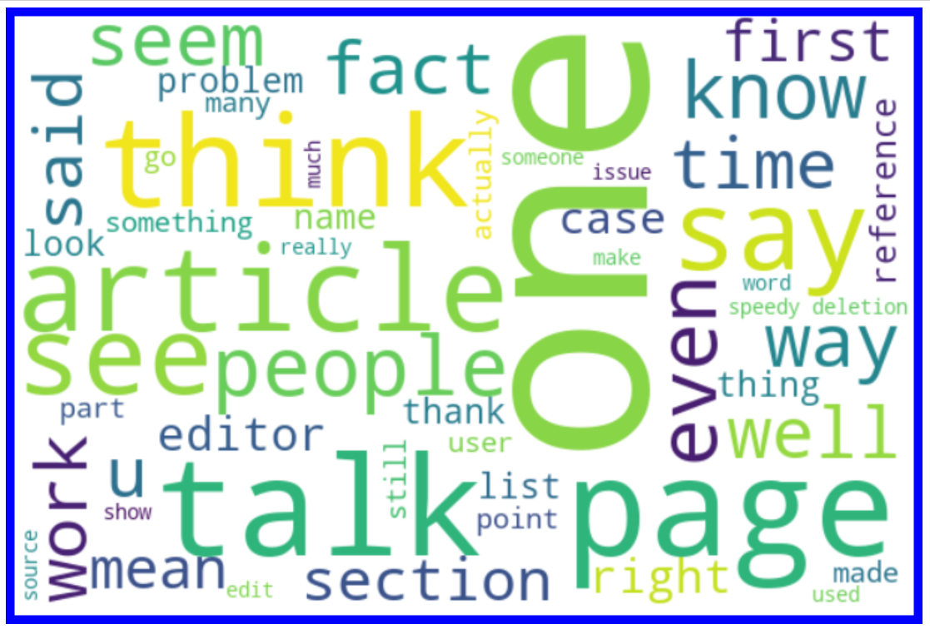
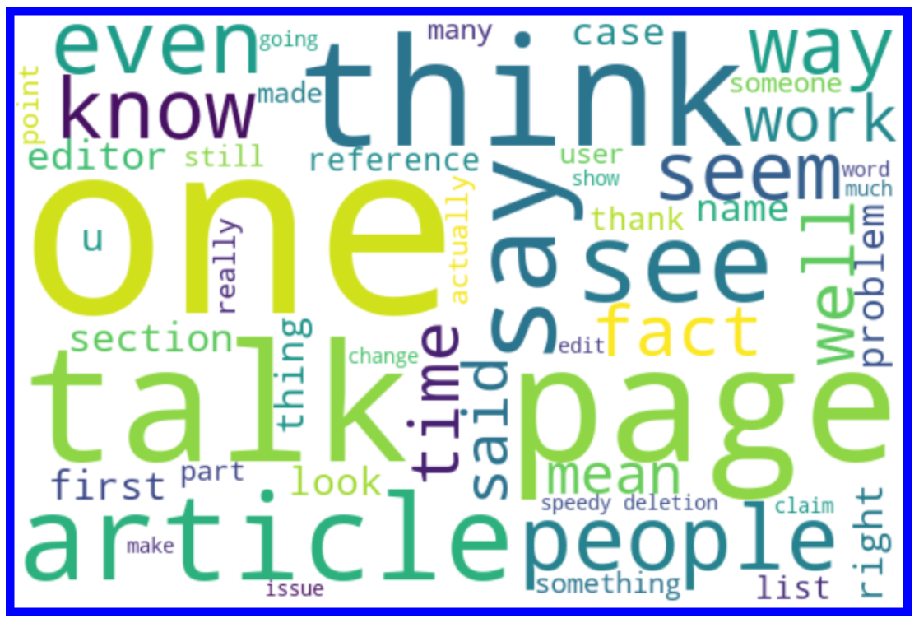
NON-OFFENSIVE WORDS
RUDE
THREAT

Slide 13
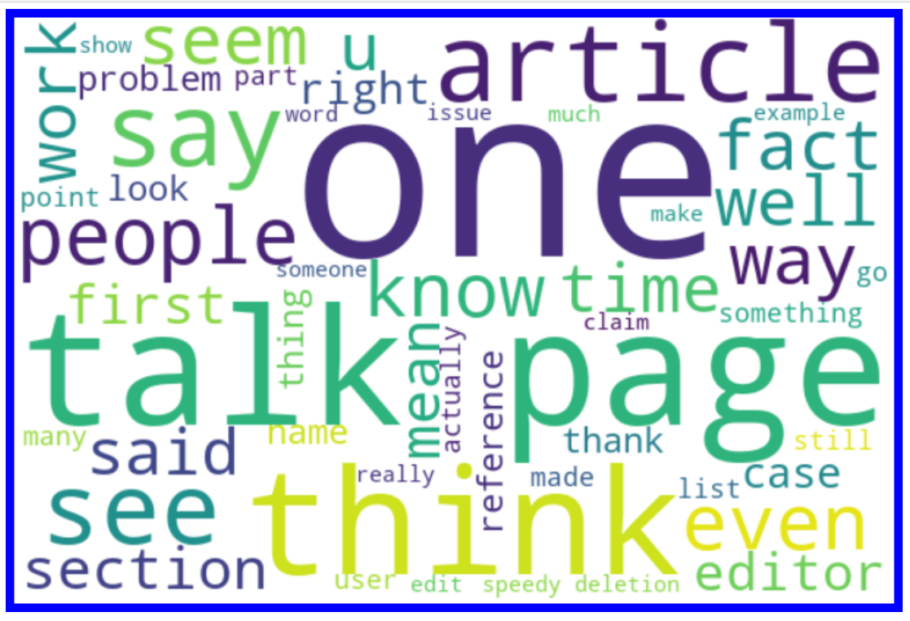
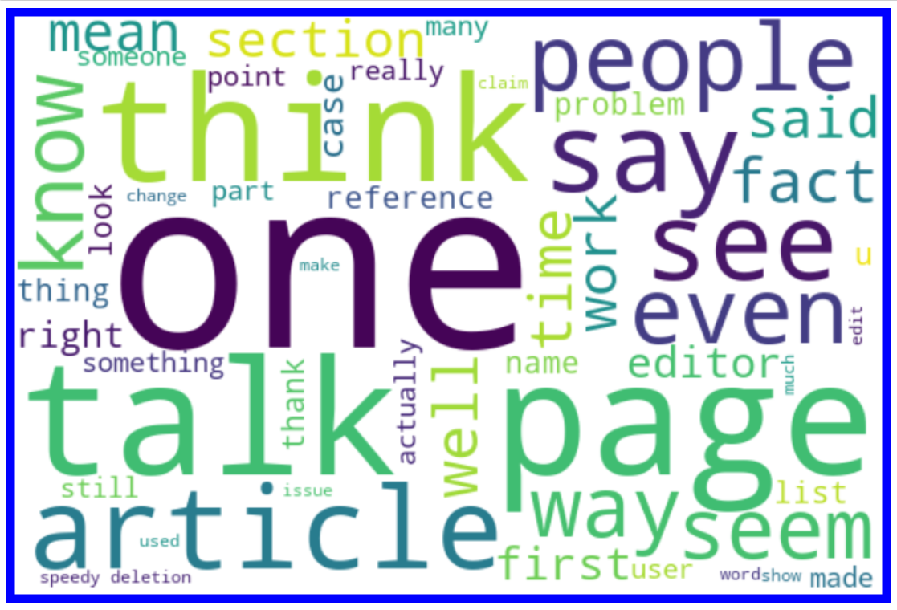
NON-OFFENSIVE WORDS
ABUSE
LOATHE

Slide 14
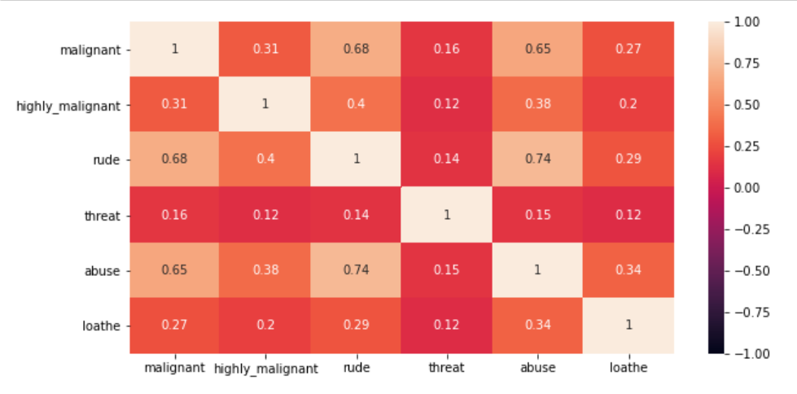

Slide 15
STEPS & ASSUMPTIONS TAKEN
Imported RegEx for matching set of strings, installed nltk library to download stopword packages, also used lemmatizer for converting words to its base form.
Imported wordcloud to visualize sense of loud words appearing more frequently in .
Converted all comment_text column texts into lower case, then removed punctuations, digits, stopwords from it.
Dropped comment_text column as the elements in it after preprocessing was stored in cleaned_comments column.
Plotted heat map to see the correlation of categorical variables.
Creating a feature named label and storing all the target columns in it.
Converting train and test data texts into vectors using TfidfVectorizer.
Using SMOTE (resampling) method to cope up with imbalanced classification of target variable.
Then started model building and testing with different algorithms to find best model and finally doing hyper parameter tuning to achieve good accuracy.

Slide 16
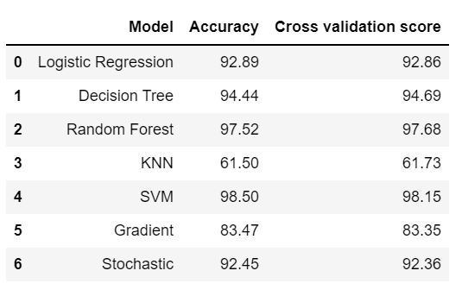
FINALIZED MODEL
Logistic Regression is our best/finalized model because the difference between its accuracy and CV score is least among all models.
After applying hyper parameter tuning on our best model (Logistic Regression) , the accuracy increased by 0.6%.

Slide 17
CONCLUSION
From the above study it has been observed that highly abusive words like ‘fuck’, ‘suck’, ‘dickhead’,‘cock’, etc. has been mostly used.
Threating words like die, kill, murder, rape has been used.
Use of Faggot word has been used which refers to gay man.
Mostly abusive words are based on racism, sexist, body shaming etc.
Black people are abused and targeted by using words like nigger.
Multinomial models are the best performing models
In conclusion we can say, malignant comments are widely spread through social media. It not only hurts people’s emotion but also result in act of violence, building model to classify these comments will help to reduce the spread.

Slide 18
THANK YOU!

